Slide 1
Like* Partner Data
November 7, 2020

Slide 2
Do the number of partners and/or the gender of the partner(s) predict use of like*?
Data set includes total uses of like* per participant (not files)

Slide 3
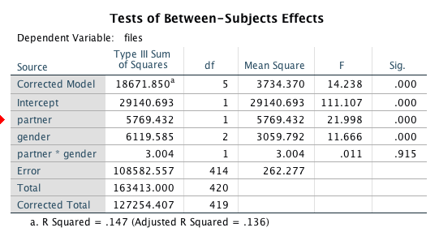
ANOVA
*
*

Slide 4
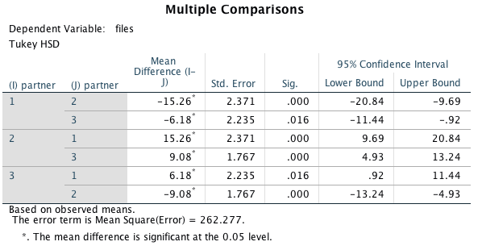
Post hoc comparisons – Number of Partners
1 = alone
2 = one partner
3 = multiple partners

Slide 5
Notes:
77
2291
1529

Slide 6
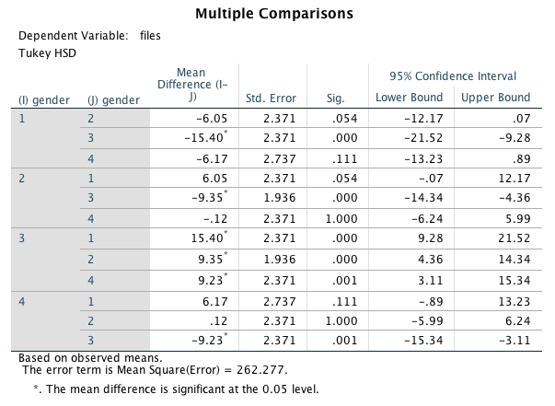
Post hoc comparisons – Gender of Partners
1 = no gender
2 = male
3 = female
4 = both

Slide 7
N.S.

